Slide 1
Behaviour Trees part 2
Extending Behaviour Trees
Programming – AI for Games
Last modified 08/02/16 by Sam Cartwright

Slide 2
Contents
Recap of Behaviour Trees
Pending Behaviours
Composite Behaviours
Parallel, Random, Switch
Decorator Behaviours
Not, Timeout, Log
Behaviour Tree Tools

Slide 3
Behaviour Tree Recap
Behaviour Trees are a method of breaking down A.I. in to discrete behaviours
Modular
Allows AND and OR conditional logic
Branch nodes are Composites of child behaviours, and leaf nodes are either Actions or Conditions
Composites add the AND and OR logic
Conditions ask a question and return Success or Failure
Actions perform the A.I. behaviours, such as “Move a step” or “Attack”

Slide 4
Behaviour Tree Recap
Actions and Conditions should be quick
Ideally perform their method and return as soon as possible
Actions should be broken down in to the smallest possible discrete action
Perform a single task, rather than many
i.e. “Step forward” action, “Play animation” action, not “Step forward and play animation X while playing sound Y and particle effect Z”
But not all behaviours can execute instantly, and not all are interruptable
Sometimes the agent needs to wait until a behaviour has completed
For example, “climbing on to a ladder” might need to wait until the animation ends before it can make other decisions

Slide 5
Pending Behaviours
It is possible that a behaviour runs longer than a single frame
We still want the behaviour to return or else it will block our program
We can add this functionality to our Behaviour Trees by adding a 3rd return type
Running, or Pending
Actions and Conditions could return this new type if they have not finished their task
Composites need to be changed to allow Pending
enum BehaviourResult
Success
Failure
Pending
class Behaviour
func execute(Agent agent)

Slide 6
Pending Behaviours
class Composite : Behaviour
list childBehaviours
Behaviour pendingChild : null
func execute(Agent agent) = 0
Composites need to keep track of any child behaviour that returns Pending
The Composite should also return Pending straight away without executing any remaining child behaviours
When a Composite is executed that had a Pending child behaviour last time it begins execution at the Pending child
Pending propagates up the tree to the root so that next time it is executed it branches down to the Pending Action or Condition
class Selector : Composite
func execute(Agent agent)
child = pendingChild
pendingChild = null
if child is null
child = childBehaviours.first
while child <= childBehaviours.last
result = child.execute(agent)
if result is Success
return Success
if result is Failure
child = next child
if result is Pending
pendingChild = child
return Pending
return Failure

Slide 7
Pending Behaviours
Patrol
Find Path
Will path once path is found
Go To Next Waypoint
Need New Path
Get Path
Finding a path may take a few frames, so returns Pending

Slide 8
Composite Behaviours
We have previously discussed the Sequence and Selector Composite Behaviours
Control the logic and flow of the tree
But there are more types of Composites available to us
Selectors could select their child behaviours at random rather than ordered, for a RandomSelector
A Switch Composite could select a child behaviour based on a switch
A Parallel Composite is a composite that can execute all of its child behaviours at the same time
Child behaviours don’t have to rely on each other or a set order
A “PlayAnimation” action doesn’t have a reliance on “PlaySound” so both could execute at the same time
Usually requires multi-threading

Slide 9
Composite Behaviours
Switch (anger)
Parallel (summon)
calm
angry
Sing
Moan
Yell
Play Anim
Spawn Particles
Play Sound
Random (fidget)
annoyed
All execute at once Parallel simply returns Success
Scratch Nose
Scratch Chin
Yawn

Slide 10
Decorator Behaviours
Another common type of Behaviour is a Decorator
A Decorator is a type of Composite Behaviour that usually only has one child
But it can contain more than one if desired
A Decorator simply modifies the tree’s logic in some way
For example, a Decorator could be setup to act as a logical NOT operator, reversing the result of its child behaviour
Decorator

Slide 11
Decorator Behaviours
class NotDecorator : Behaviour
Behaviour child
func execute(Agent agent)
result = child.execute(agent)
switch (result)
case Success: return Failure
case Failure: return Success
Decorators are useful for modifying the tree logic
A Decorator could be setup to only allow its child behaviour to execute 5 times
After the 5th time it always returns Failure
A Decorator could have a timeout, requiring a certain amount of time to elapse before the child behaviour can execute again
Always returns Failure if the timeout is still running
They can also be useful for debugging purposes
The Decorator could log any time it executes its child behaviour
class TimeoutDecorator : Behaviour
Behaviour child
float timeout, duration
func execute(Agent agent)
timeout -= deltaTime
if timeout > 0
return Failure
timeout = duration
return child.execute(agent)
class LogDecorator : Behaviour
Behaviour child
string message
func execute(Agent agent)
print message
return child.execute(agent)

Slide 12
Decorator Example
Patrol
Follow Path
Log “Finding Path”
! (not)
Go To Next Waypoint
Get Path
Need New Path

Slide 13
Behaviour Tree Tools
One benefit of Behaviour Trees is the logic
Easy to understand for artists and designers
A common occurrence in studios is the creation of a Behaviour Tree editing tool
This way designers can design the game and A.I. logic without needing a programmer, in the way that they like
The game is developed quicker
Data driven design allows fast iterative design

Slide 14
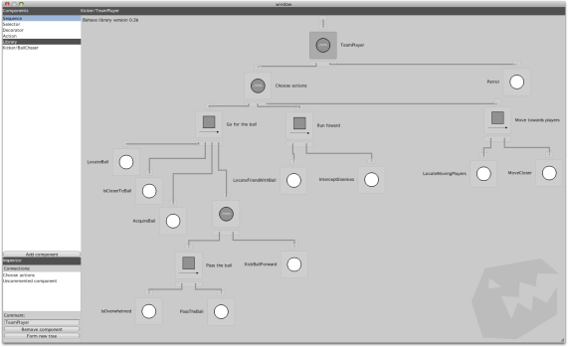
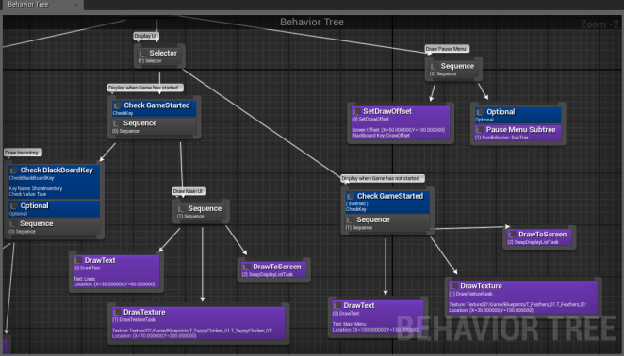
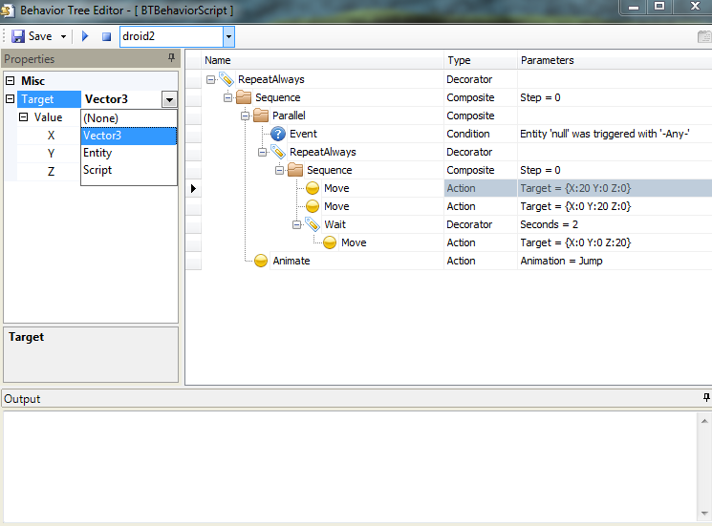
Behaviour Tree Tools
Various tools exist in common game engines
Unity3D plugin “Behave”
Unreal Engine 4 Behavior Tree
You can also create your own
Simple tree editors can be written with C#
XML can be used as a file format

Slide 15
Summary
Behaviour Trees are extremely powerful and extensible
Custom behaviours and complex logic can be easy to implement
Starting with 2 simple Composites, Selector and Sequence, we can construct A.I. for a vast range of agents

Slide 16
References
Ian Millington, 2009. Artificial Intelligence for Games. 2 Edition. CRC Press.

